Slide 1
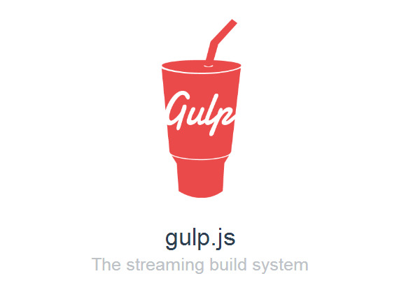
Gulp.js Introduction
A brief overview of the four functions available in the Gulp API and how to use them, and Gulp plugins to aid your web development workflow.
http: //gulpjs.com
Notes:
https://www.youtube.com/watch?v=dwSLFai8ovQ
https://scotch.io/tutorials/automate-your-tasks-easily-with-gulp-js

Slide 2
Mike Hamilton
Senior Consultant, Neudesic, @mikescott8 Founder & Co-Organizer, NWVDNUG (Northwest Valley .Net User Group), @nwvdnug

Slide 3
Requirements
Node/NPM
Gulp.js
Editor/IDE
Need Node installed so that you have NPM (Node Package Manager).
NPM is used to install Gulp.Js and plugins for Gulp processing.
After Node is installed, at a command prompt in directory for project type:
npm install --global gulp-cli npm init npm install –save-dev gulp

